Slide 1
Chapter 7
Text Input/Output
Objectives
❏ To understand the basic properties and characteristics of external files
❏ To understand the C implementation of file I/O using streams
❏ To write programs that read and write text files using the formatting functions
❏ To write programs that read and write text files using the C character I/O
functions
❏ To write programs that handle simple I/O errors
❏ To understand and implement basic data validation concepts

Slide 2
7-1 Files
A file is an external collection of related data treated as a unit. The primary purpose of a file is to keep a record of data. Since the contents of primary memory are lost when the computer is shut down, we need files to store our data in a more permanent form.
Topics discussed in this section:
File Name
File Information Table

Slide 3
Note
A file is an external
collection of related data treated as a unit.

Slide 4
7-2 Streams
As we briefly discussed in Chapter 2, data is input to and output from a stream. A stream can be associated with a physical device, such as a terminal, or with a file stored in auxiliary memory.
Topics discussed in this section:
Text And Binary Streams
Stream-File Processing
System-Created Streams

Slide 5
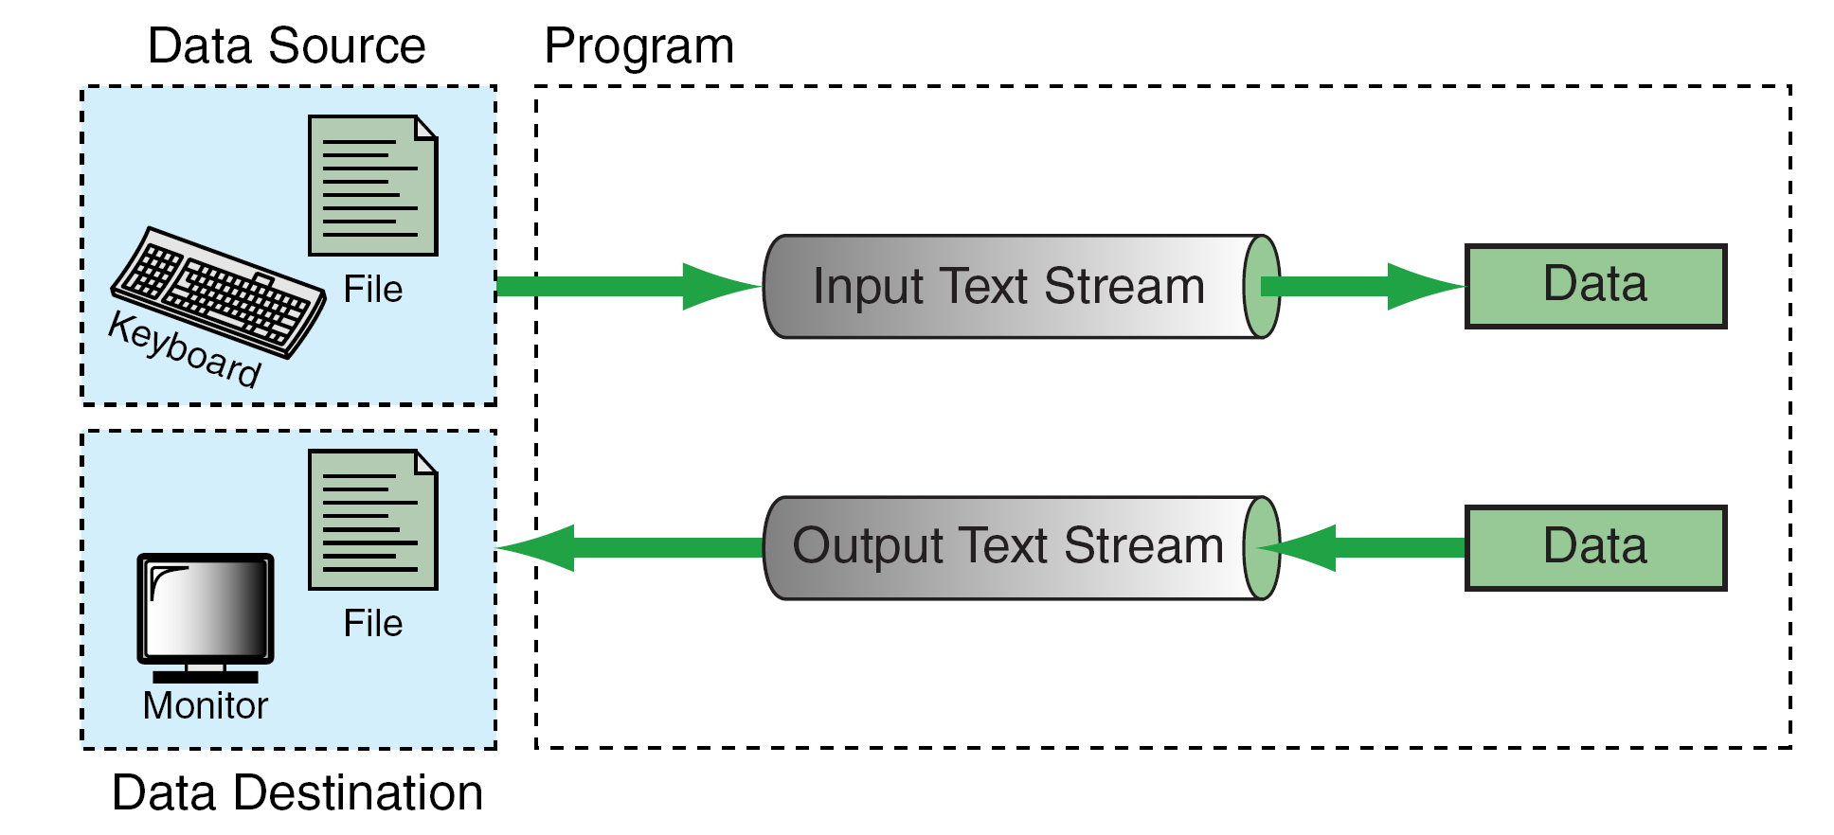
FIGURE 7-1 Streams

Slide 6
Note
Standard stream names have
already been declared in the stdio.h header
file and cannot be declared again in our program.

Slide 7
Note
There is no need to open and close the standard streams.
It is done automatically by the operating system.

Slide 8
7-3 Standard Library Input/Output
Functions
The stdio.h header file contains several different input/output function declarations. They are grouped into eight different categories, as shown in Figure 7-2.
The first three will be discussed in the following sections. Those shown in shaded boxes will be discussed in Chapters 11 and 13.
Topics discussed in this section:
File Open and Close

Slide 9
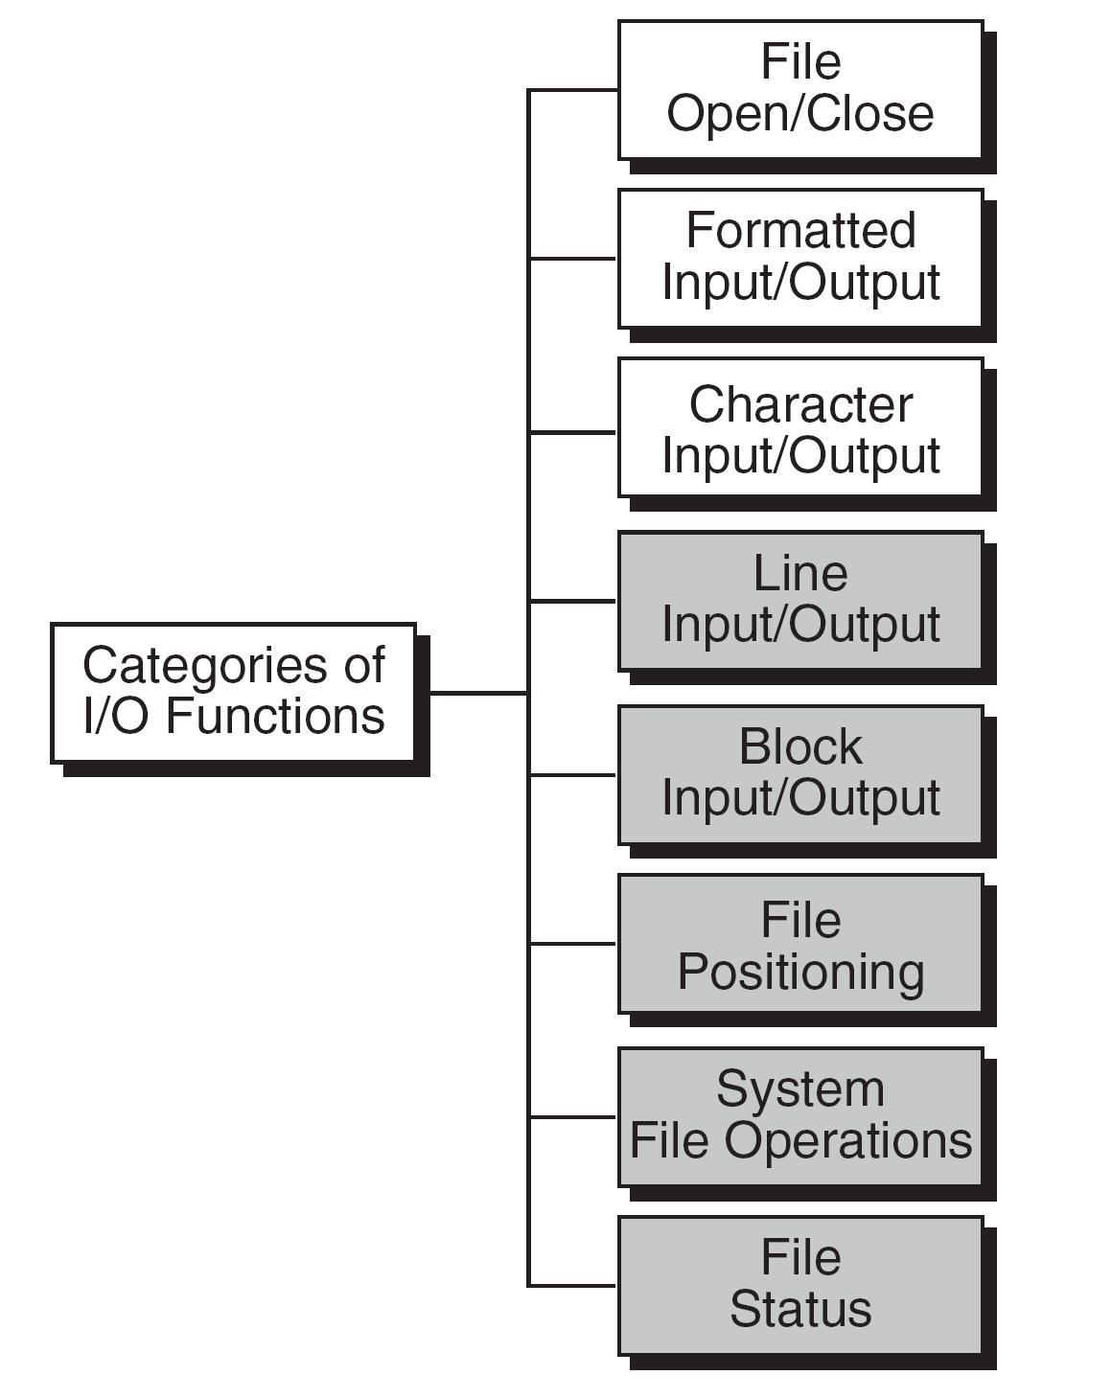
FIGURE 7-2 Categories of Standard Input/Output Functions

Slide 10
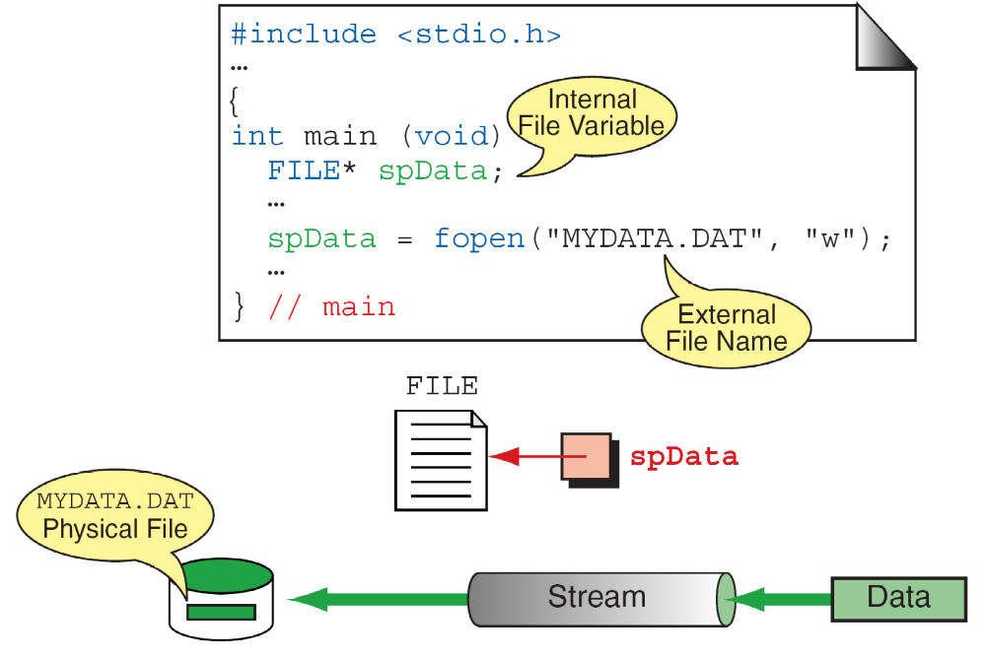
FIGURE 7-3 File Open Results

Slide 11
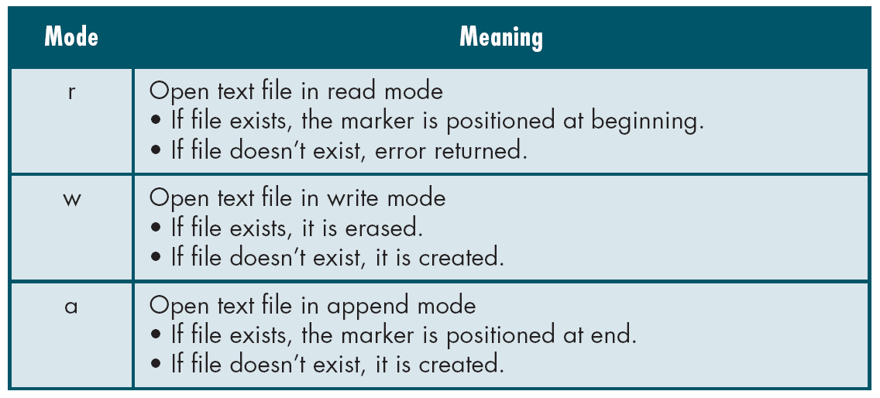
Table 7-1
Text File Modes

Slide 12
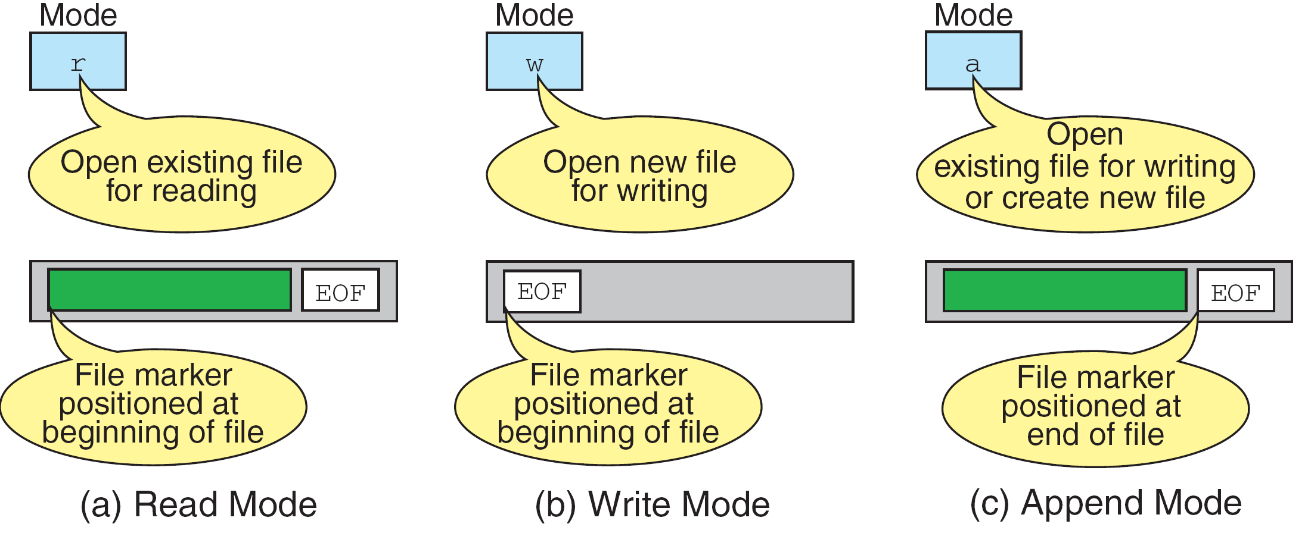
FIGURE 7-4 File-Opening Modes

Slide 13
PROGRAM 7-1
Testing for Open and Close Errors

Slide 14
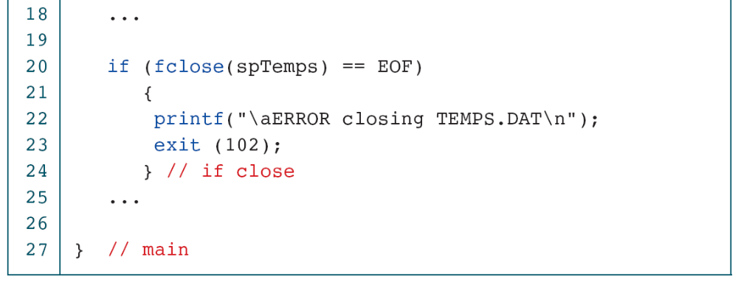
PROGRAM 7-1
Testing for Open and Close Errors

Slide 15
7-4 Formatting Input/Output
Functions
In Chapter 2 we introduced two formatting input/output functions, scanf and printf. These two functions can be used only with the keyboard and monitor. The C library defines two more general functions, fscanf and fprintf, that can be used with any text stream.
Topics discussed in this section:
Stream Pointer
Format Control Strings
Input Formatting (scanf and fscanf)
Output Formatting (printf and fprintf)

Slide 16
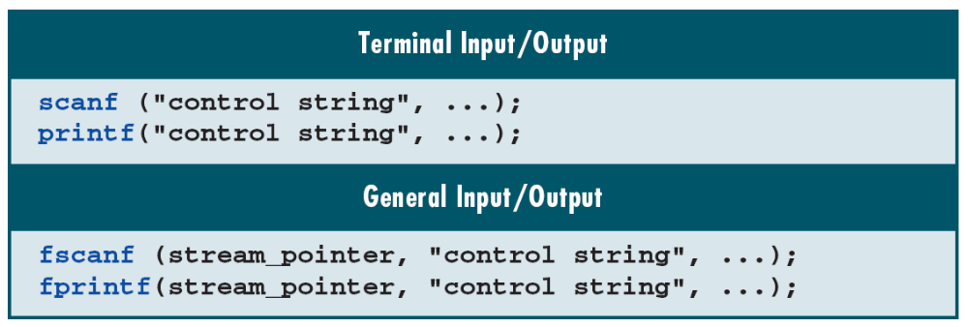
Table 7-2
Formatting Functions

Slide 17
Note
A whitespace character in an input format string causes leading whitespace characters in the input to be
discarded. A whitespace character in an output
format string is copied to the output stream.

Slide 18
Note
The number, order, and type of the conversion specifications must match the number, order, and type of the parameters in the list. Otherwise, the result will be unpredictable and may terminate the input/output function.

Slide 19
FIGURE 7-5 Conversion Specifications

Slide 20
Note
scanf reads from stdin;
fscanf reads from a user-specified stream.

Slide 21
Table 7-3
Sizes and Conversion Code for scanf Family

Slide 22
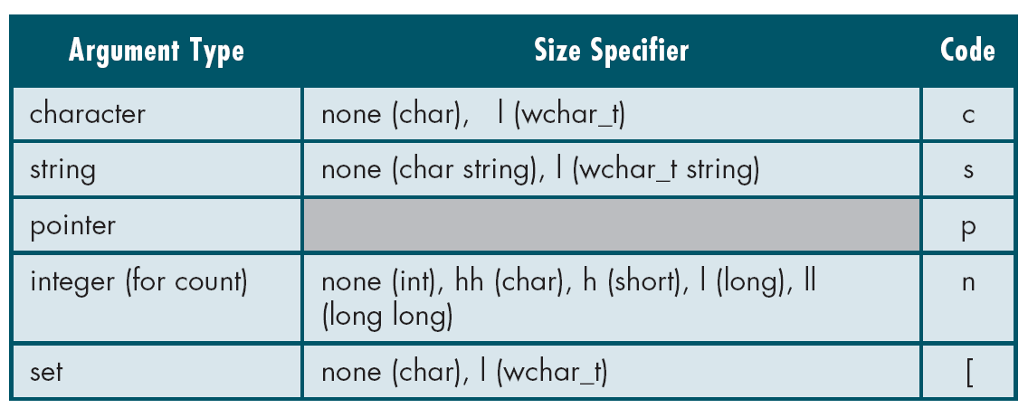
Table 7-3
Sizes and Conversion Code for scanf Family

Slide 23
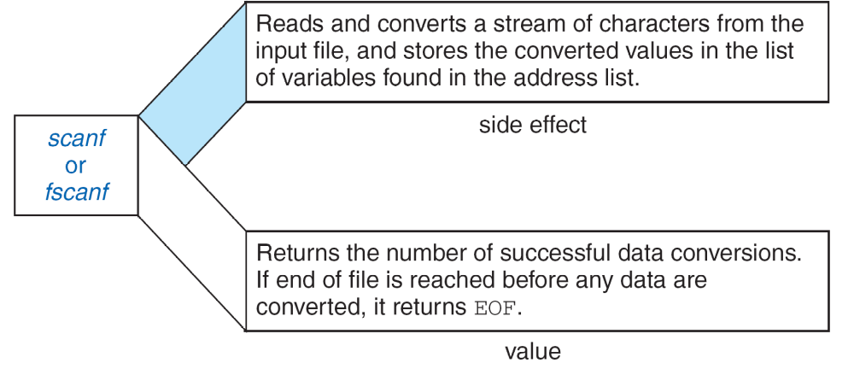
FIGURE 7-6 Side Effect and Value of scanf and fscanf

Slide 24
FIGURE 7-7 Another Common Error

Slide 25
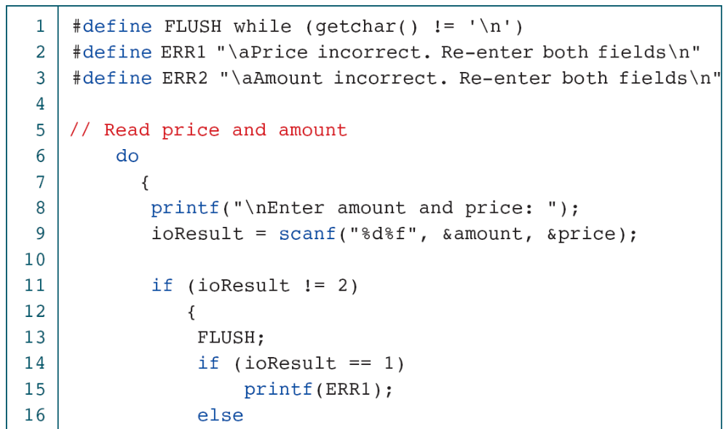
PROGRAM 7-2
Checking scanf Results

Slide 26
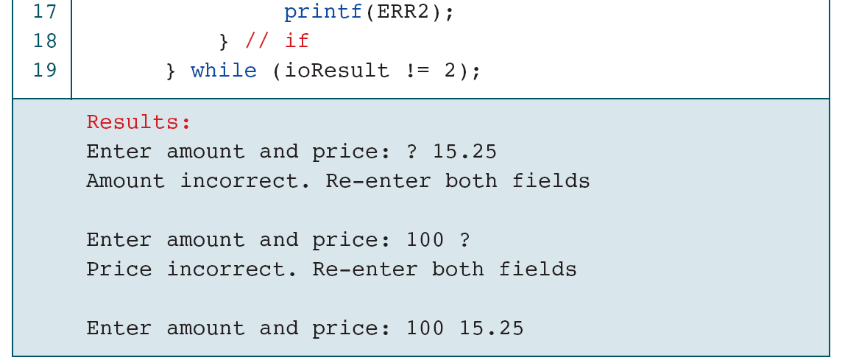
PROGRAM 7-2
Checking scanf Results

Slide 27
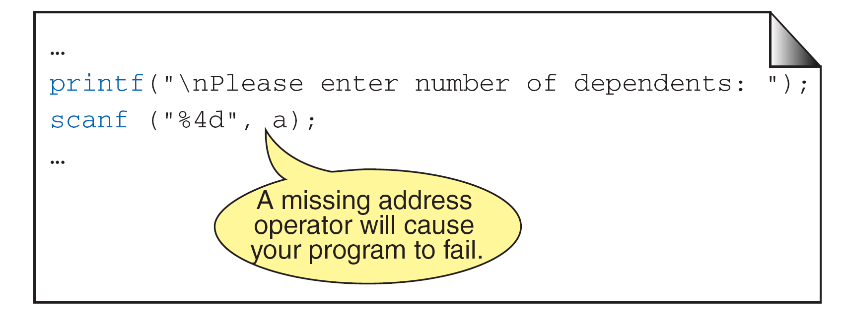
FIGURE 7-8 Missing Address Operator in scanf

Slide 28
FIGURE 7-9 Data Type Conflict

Slide 29
FIGURE 7-10 fscanf Examples

Slide 30
Note
Discarding the return character is different
from consuming it.
Discarding can be done by whitespaces
in the control string;
consuming can only be done by reading
the return character with a %c.

Slide 31
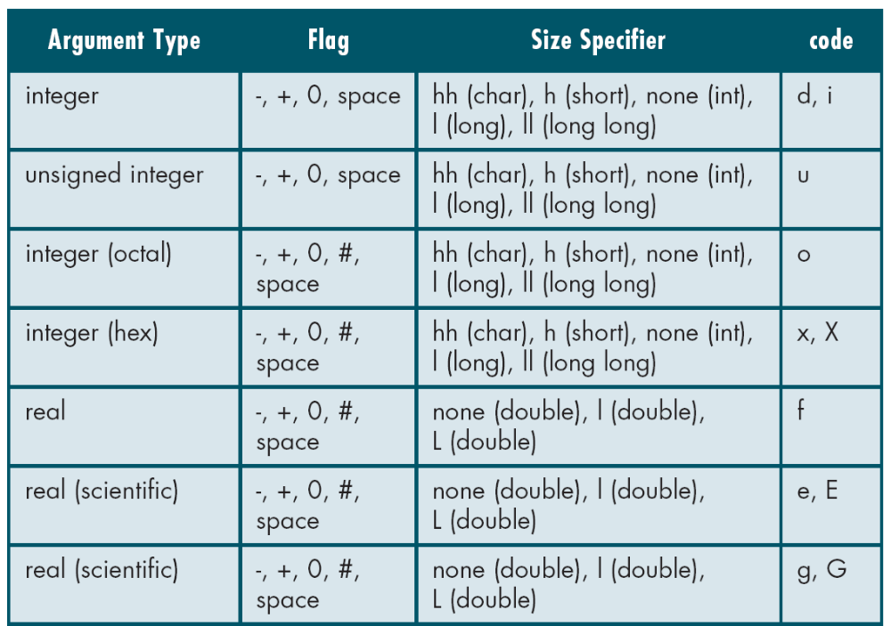
Table 7-4
Flags, Sizes, and Conversion Codes for printf Family

Slide 32
Table 7-4
Flags, Sizes, and Conversion Codes for printf Family

Slide 33
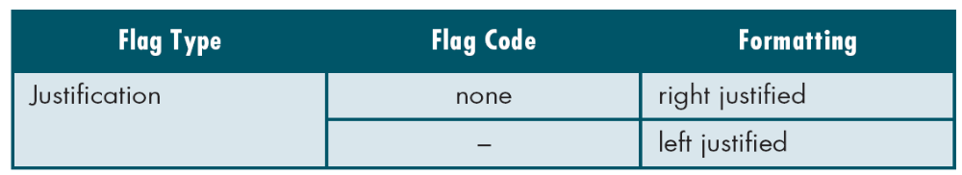
Table 7-5
Flag Formatting Options

Slide 34
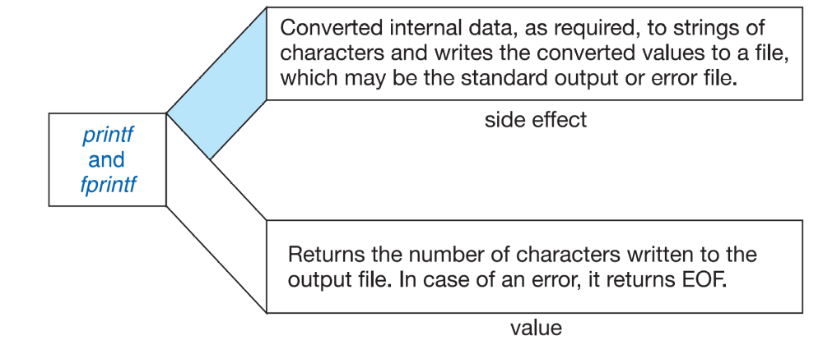
FIGURE 7-11 Side Effect and Value of printf

Slide 35
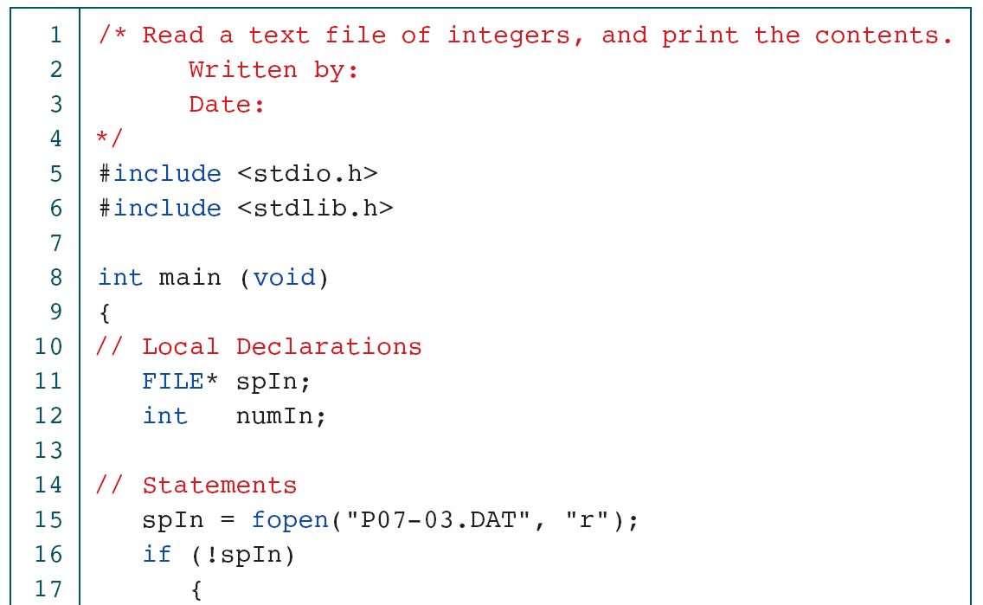
PROGRAM 7-3
Read and Print Text File of Integers

Slide 36
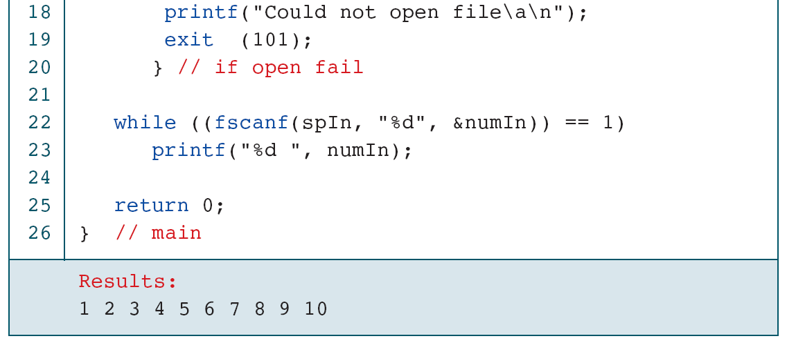
PROGRAM 7-3
Read and Print Text File of Integers

Slide 37
PROGRAM 7-4
Copy Text File of Integers

Slide 38
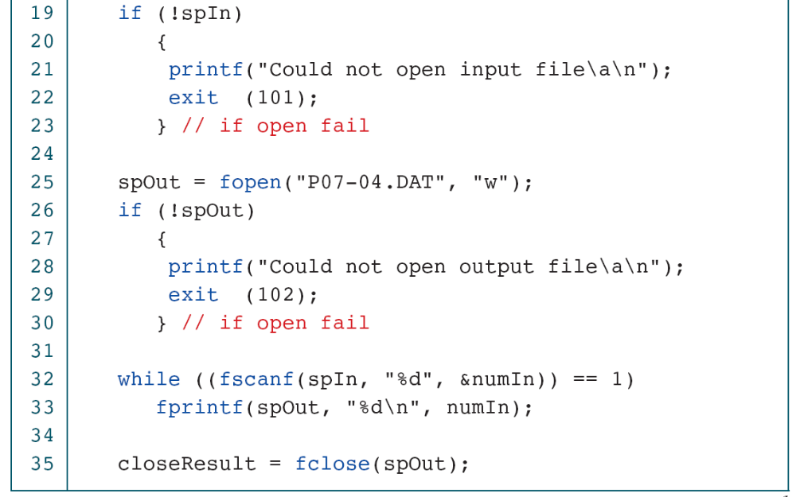
PROGRAM 7-4
Copy Text File of Integers

Slide 39
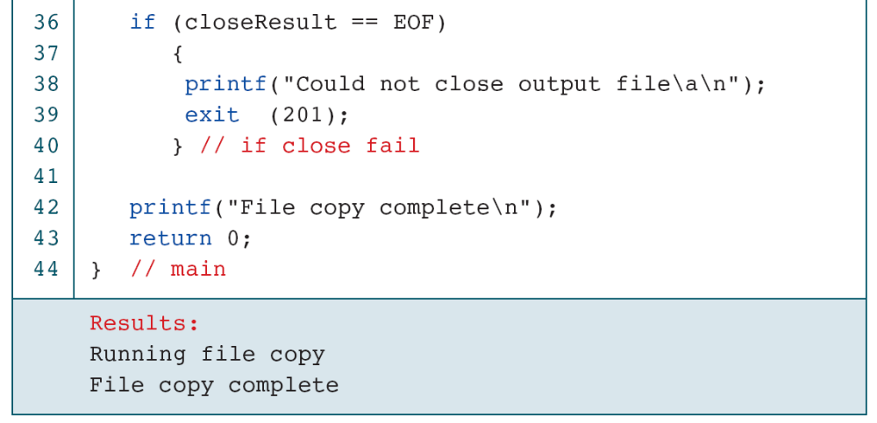
PROGRAM 7-4
Copy Text File of Integers

Slide 40
PROGRAM 7-5
Append Data to File

Slide 41
PROGRAM 7-5
Append Data to File

Slide 42
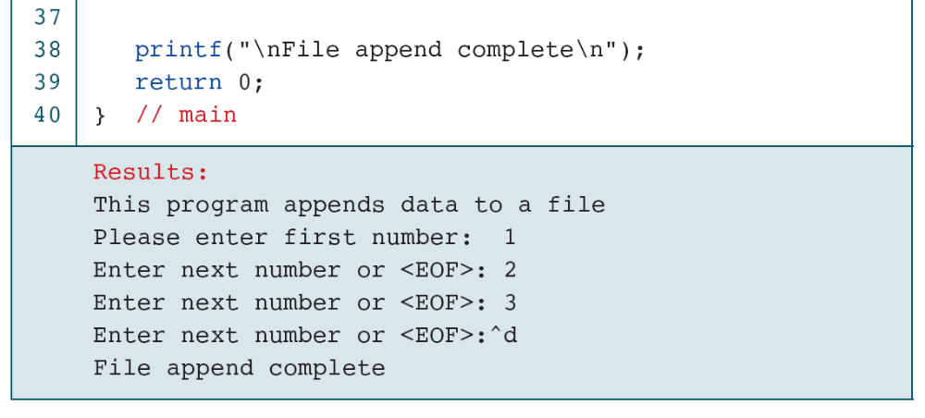
PROGRAM 7-5
Append Data to File

Slide 43
PROGRAM 7-6
Student Grades

Slide 44
PROGRAM 7-6
Student Grades

Slide 45
PROGRAM 7-6
Student Grades

Slide 46
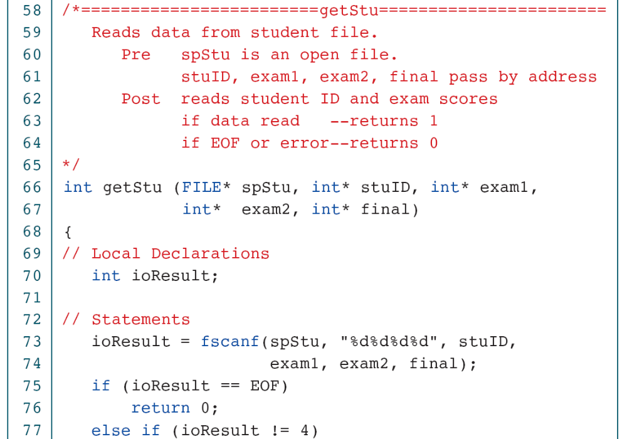
PROGRAM 7-6
Student Grades

Slide 47
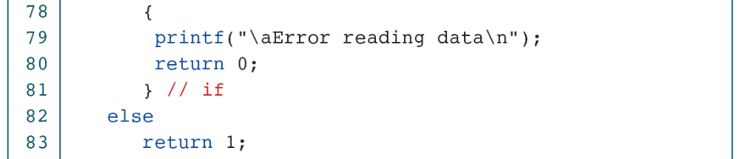
PROGRAM 7-6
Student Grades

Slide 48
PROGRAM 7-6
Student Grades

Slide 49
PROGRAM 7-6
Student Grades

Slide 50
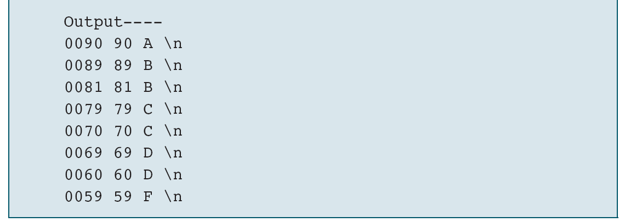
PROGRAM 7-6
Student Grades

Slide 51
7-5 Character Input/Output
Functions
Character input functions read one character at a time from a text stream. Character output functions write one character at the time to a text stream.
Topics discussed in this section:
Terminal Character I/O
Terminal and File Character I/O
Character Input/Output Examples

Slide 52
FIGURE 7-12 Character Input/Output Functions

Slide 53
PROGRAM 7-7
Create Text File

Slide 54
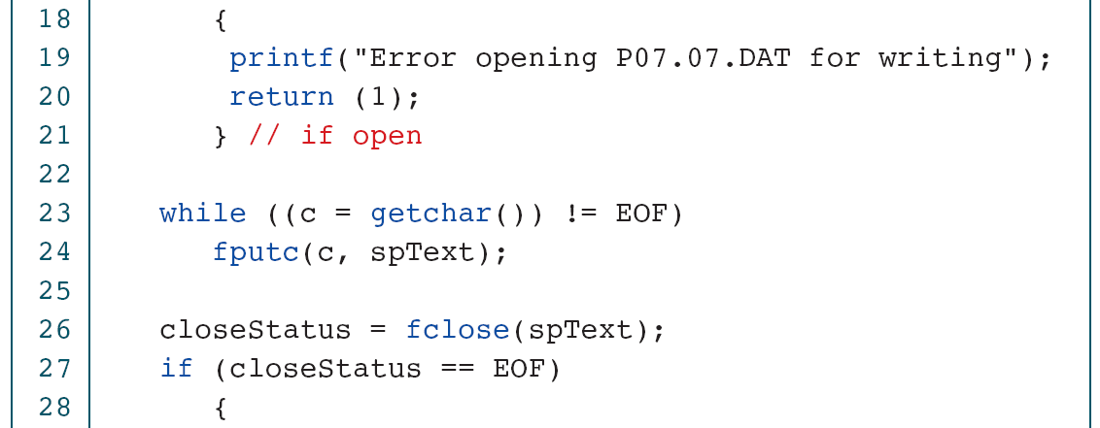
PROGRAM 7-7
Create Text File

Slide 55
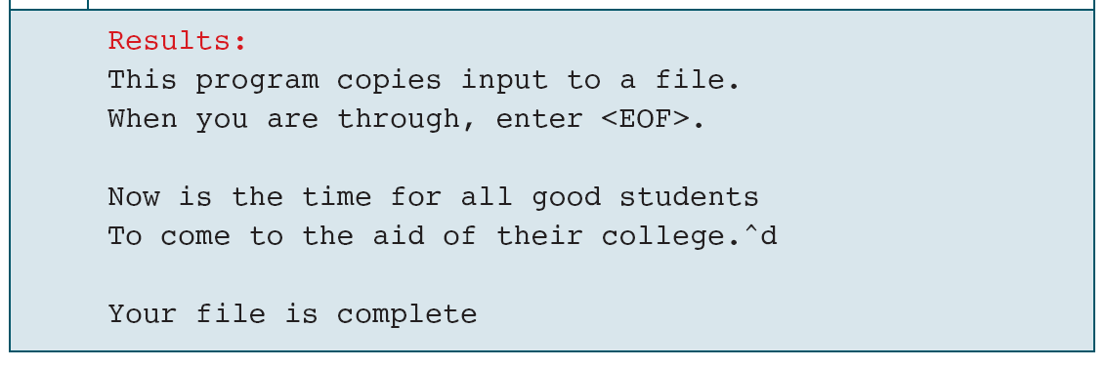
PROGRAM 7-7
Create Text File

Slide 56
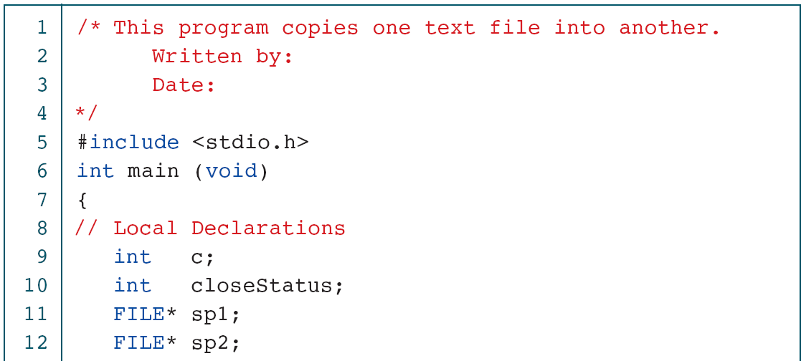
PROGRAM 7-8
Copy Text File

Slide 57
PROGRAM 7-8
Copy Text File

Slide 58
PROGRAM 7-9
Count Characters and Lines

Slide 59
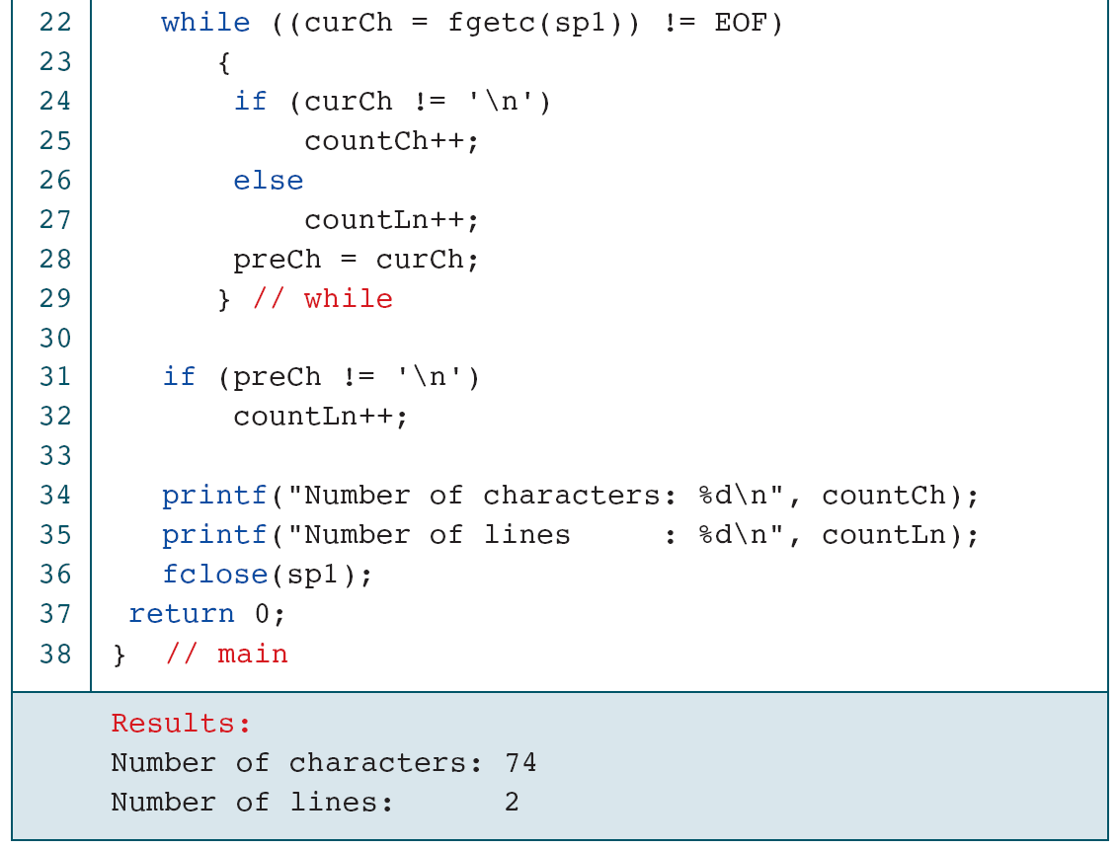
PROGRAM 7-9
Count Characters and Lines

Slide 60
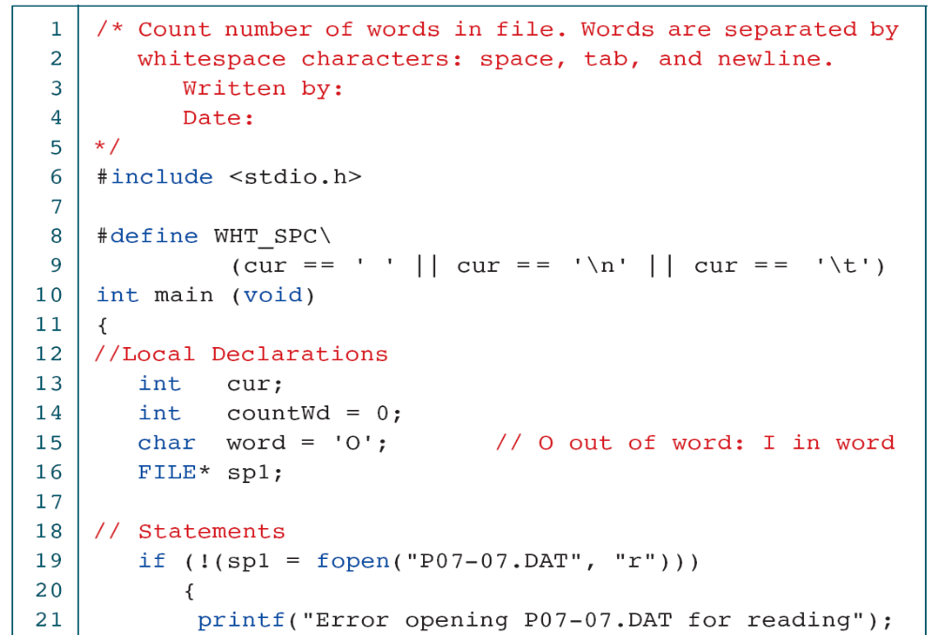
PROGRAM 7-10
Count Words

Slide 61
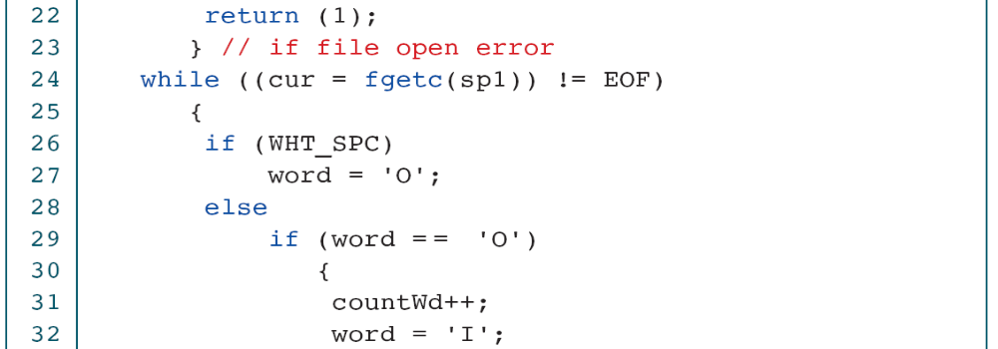
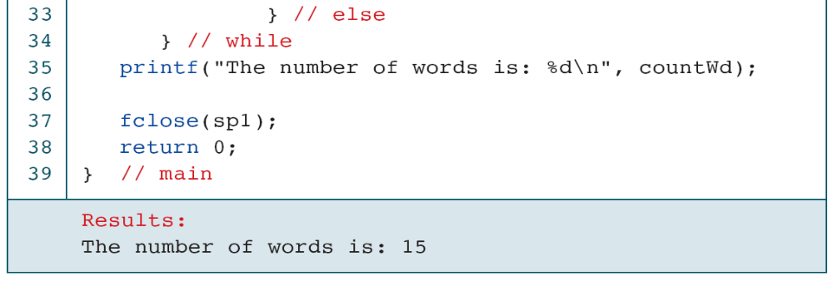
PROGRAM 7-10
Count Words

Slide 62
7-6 Software Engineering
In this section, we discuss some software engineering issues related to files.
Topics discussed in this section:
Testing Files
Data Terminology

Slide 63
PROGRAM 7-11
Handling Errors—the Right Way

Slide 64
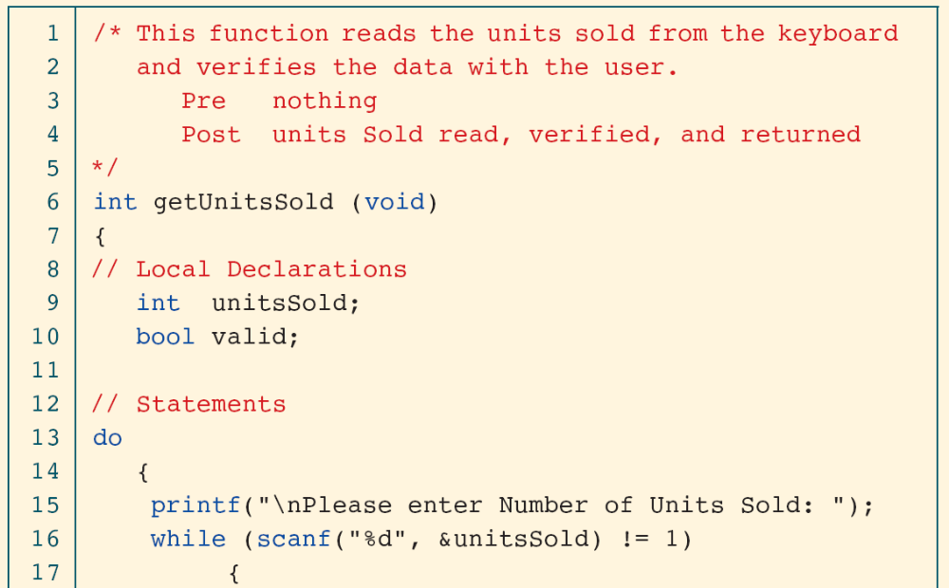
PROGRAM 7-12
Handling Errors with Explanations

Slide 65
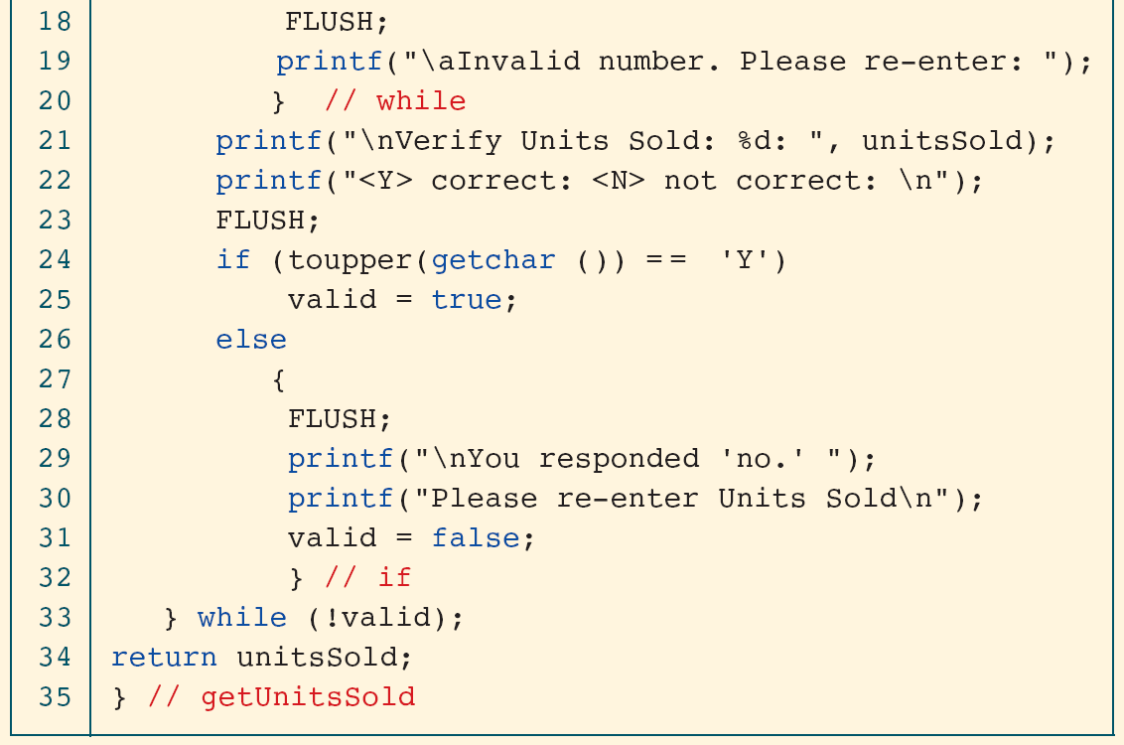
PROGRAM 7-12
Handling Errors with Explanations

Slide 66
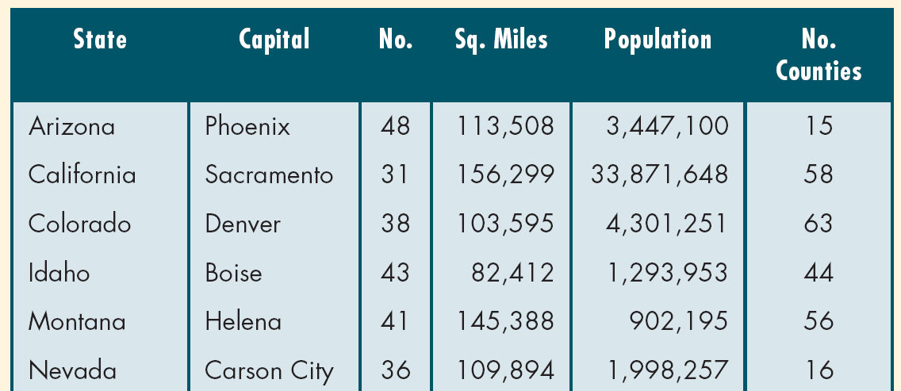
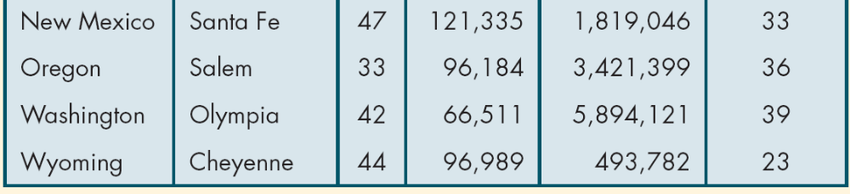
Table 7-6
Ten Western States (2000 Census)

